Slide 1
Project One
Heavy Metal Poisoning and Cardiovascular Disease

Slide 2
Project Premise
The purpose of this project is to investigate if there is a link between exposure to heavy metals and cardiovascular health problems in the United States.
The hypothesis being tested is whether people who have higher levels of heavy metals in their blood are more likely to have high blood pressure, high cholesterol levels, or abnormal heart rhythms - which are all risk factors for cardiovascular disease.

Slide 3
Source Material
National Health and Nutrition Examination Survey (NHANES Datasets)
Surveyed: 2013-2014
https://www.kaggle.com/datasets/cdc/national-health-and-nutrition-examination-survey
Heavy Metal Poisoning and Cardiovascular Disease (National Library of Medicine)
Published: September 8, 2011
https://www.ncbi.nlm.nih.gov/pmc/articles/PMC3168898/
https://www.ncbi.nlm.nih.gov/pmc/articles/PMC6801511/
Environmental Toxic Metal Contaminants and Risk of Cardiovascular Disease
Published: August 29, 2018
https://www.bmj.com/content/362/bmj.k3310
Metal biomarker mixtures and blood pressure in the United States
Published: February 14, 2021
https://www.ncbi.nlm.nih.gov/pmc/articles/PMC7883578/
DATASET

Slide 4
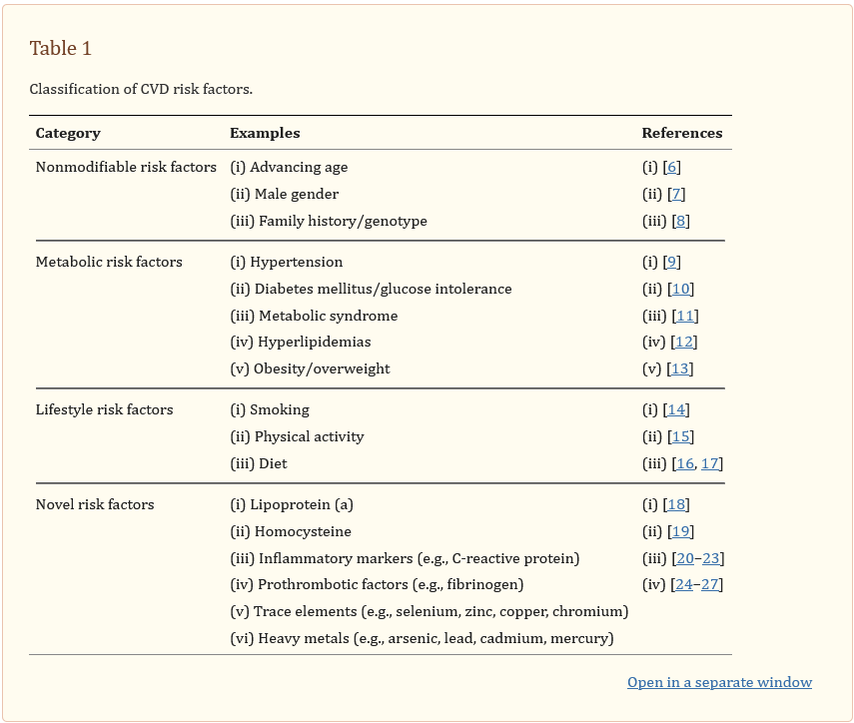
Heavy Metal Poisoning and Cardiovascular Disease

Slide 5
Analytical Process
1. Collect data: Collect relevant data on heavy metal exposure and cardiovascular health.
2. Clean and preprocess data: Clean and preprocess the data to remove any errors, inconsistencies, or missing values.
3. Analyze data: Use statistical methods and data visualization techniques to explore the relationship between heavy metal exposure and cardiovascular health. Among several tests a correlation analysis was performed to examine the relationship between blood lead levels and the risk of heart disease.
4. Interpret results: Interpret the results of the data analysis and draw conclusions based on the findings. Discuss the implications of the results for public health policy and environmental regulations.
5. Communicate findings: Communicate findings to a broader audience through a report, presentation, and data visualization.

Slide 6
Dataset - National Health and Nutrition Examination Survey (NHANES)
The dataset featured well-documented information on the levels of heavy metals contained in each participant that our hypothesis was seeking to test. Specifically: - Lead - Cadmium - Selenium - Manganese - Mercury
The same participants were also tested on the lipid levels known to be associated with cardiovascular health. Specifically: - HDL Cholesterol (good) - LDL Cholesterol (bad) - Triglycerides

Slide 7
First Analysis

Slide 8
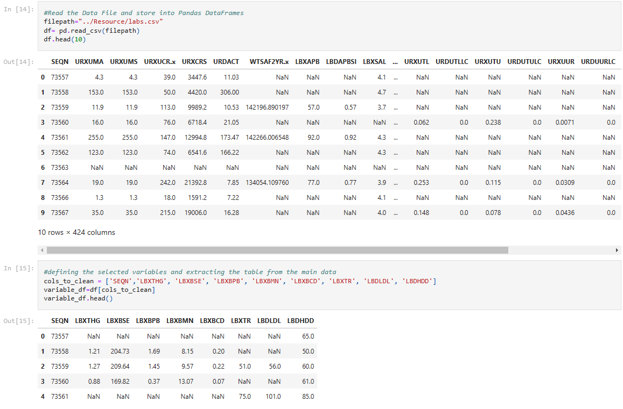

Slide 9
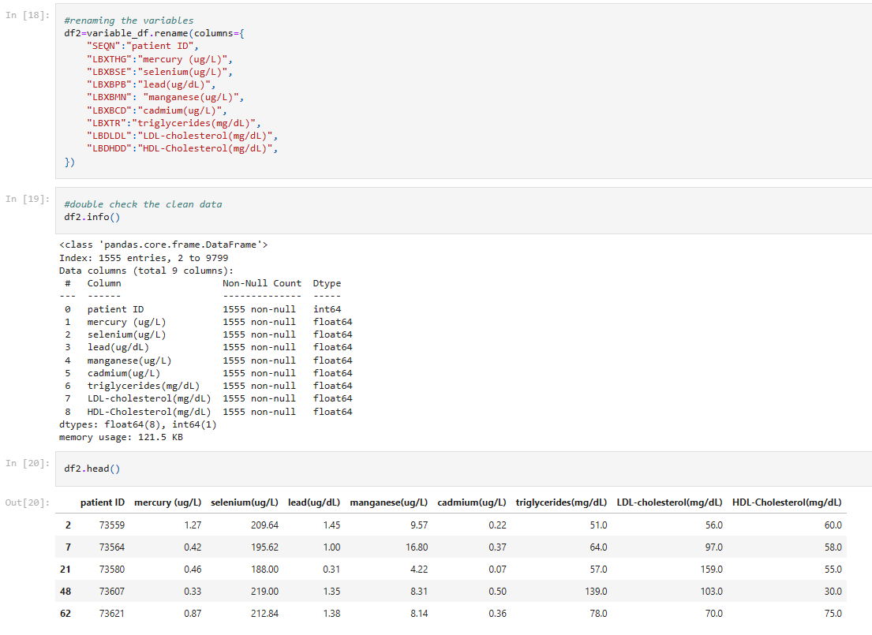

Slide 10
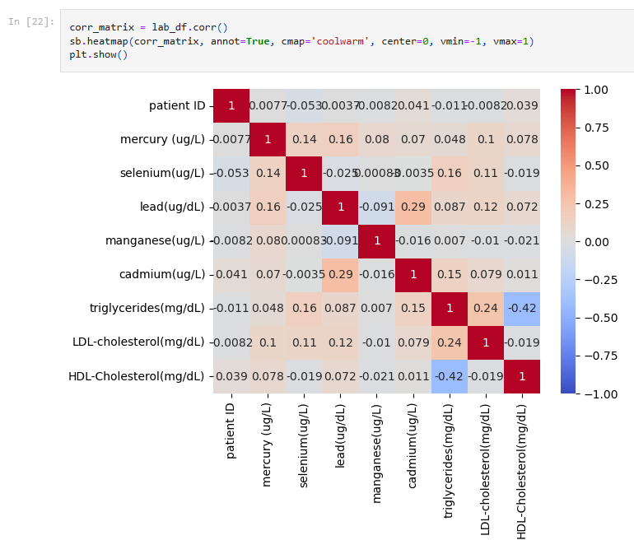
HEATMAP

Slide 11
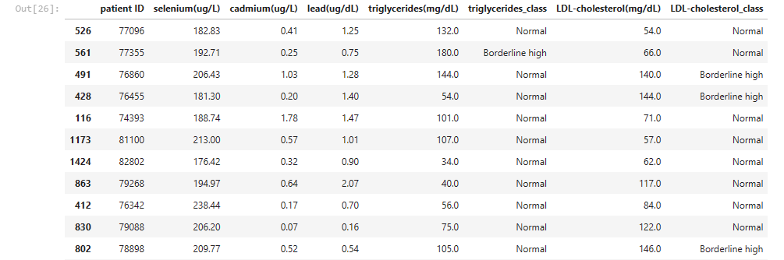
Data Comparison to Medical Norms

Slide 12
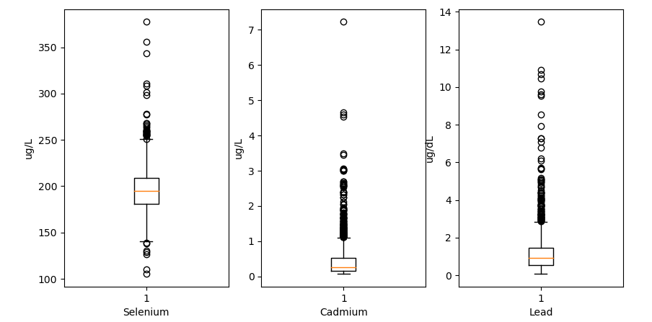
Quartiles of Heavy Metals

Slide 13
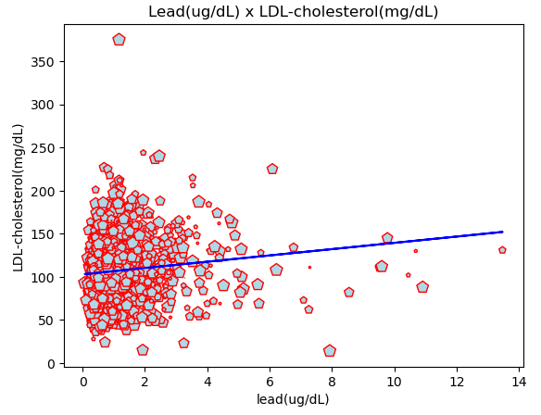
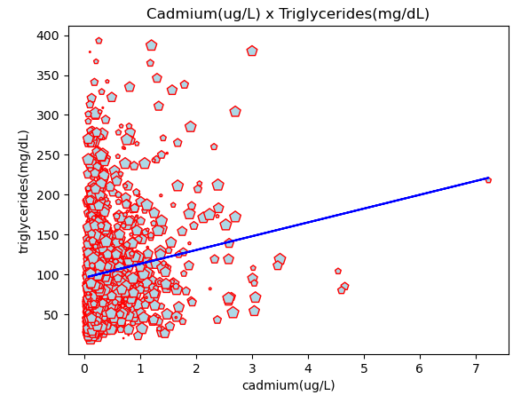
Searching For Correlations

Slide 14
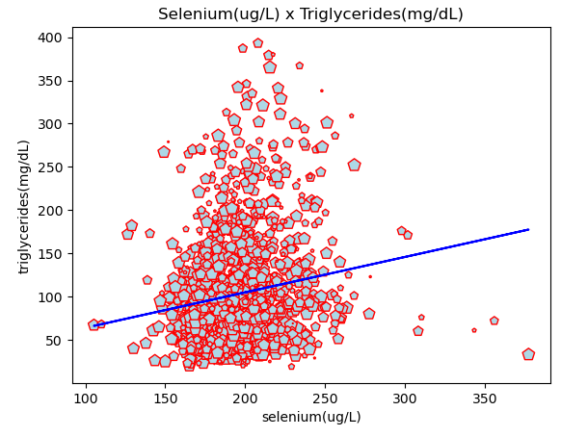
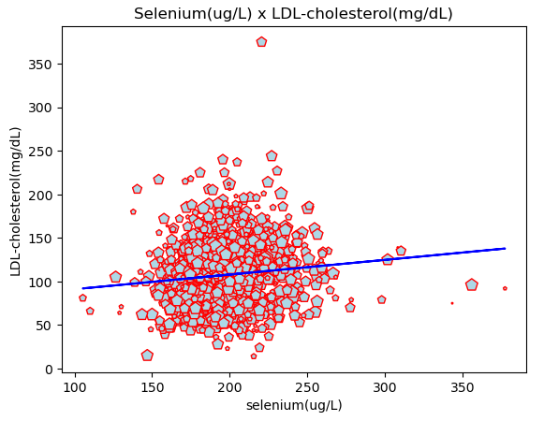
Searching For Correlations

Slide 15
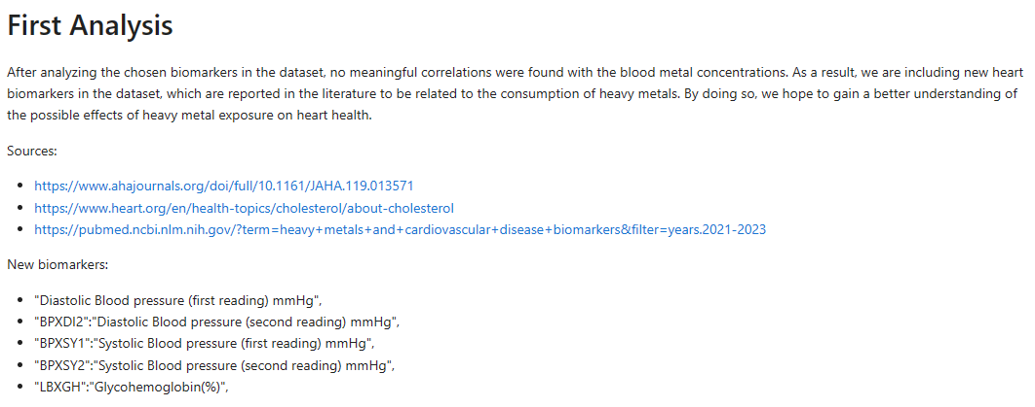
Observations

Slide 16
Adding New Data

Slide 17
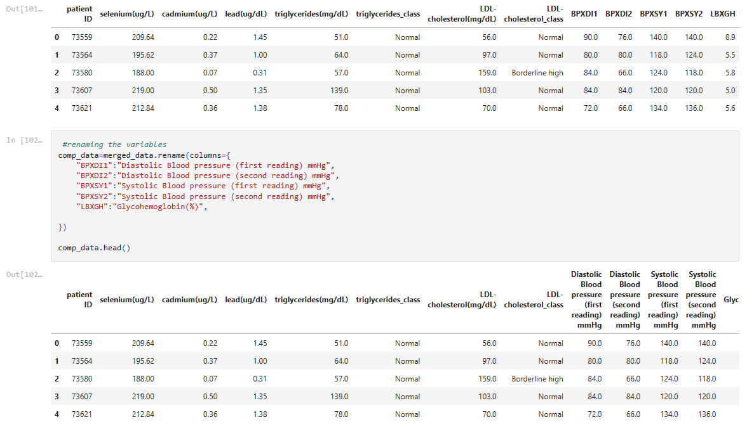

Slide 18
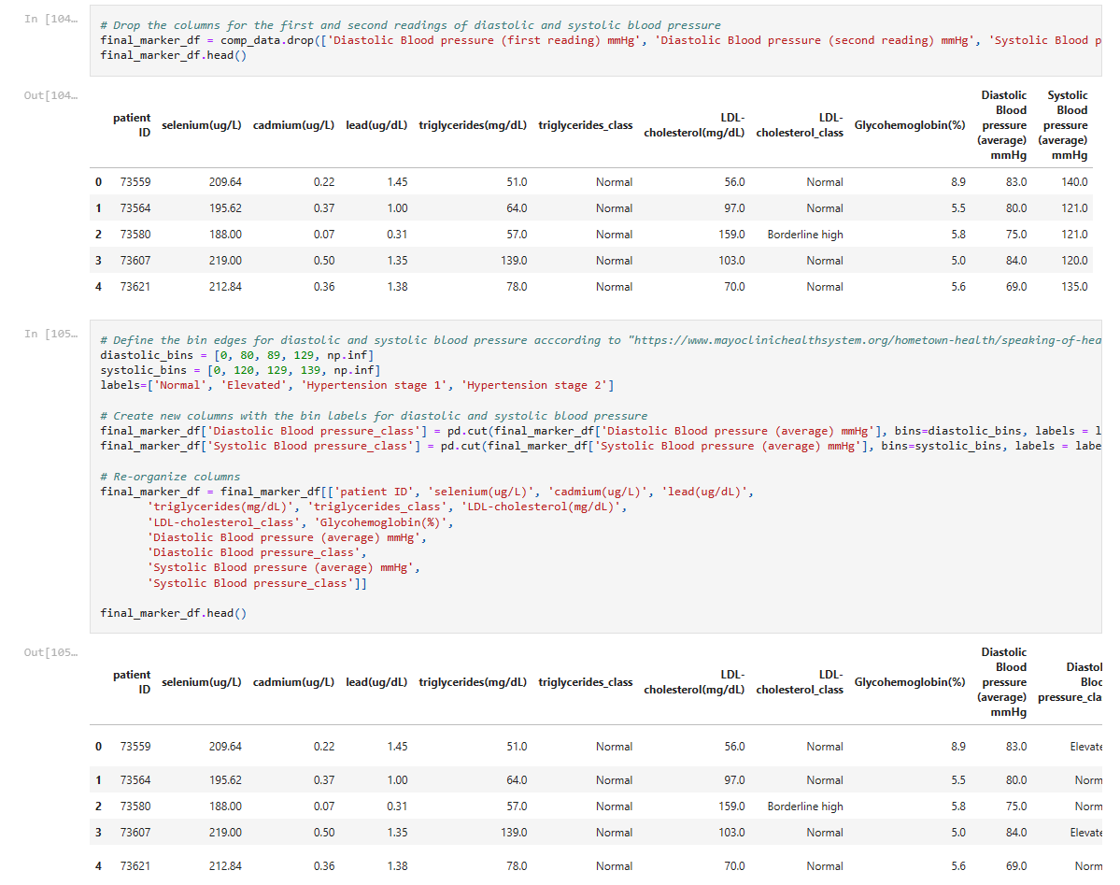

Slide 19
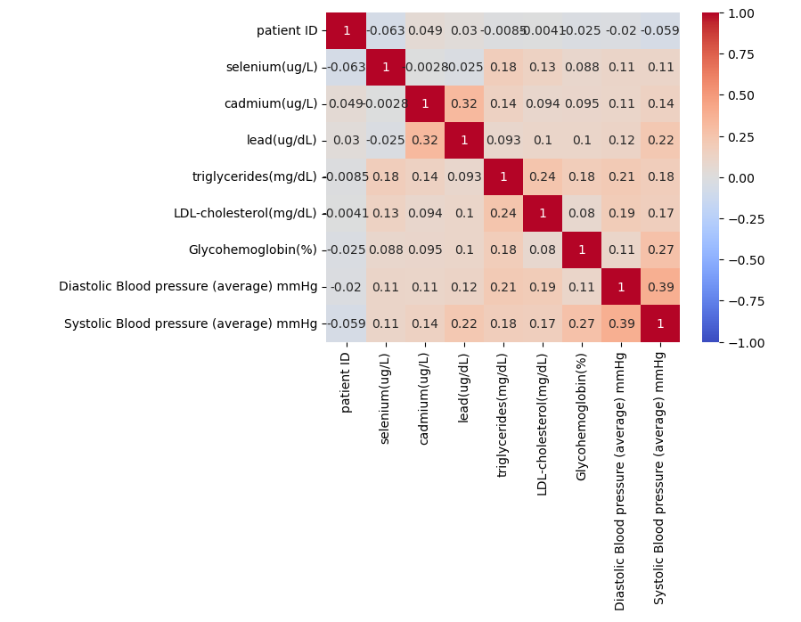
Heat Map 2

Slide 20
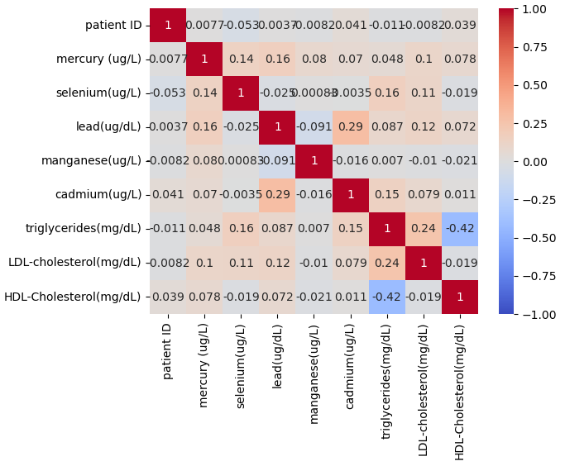
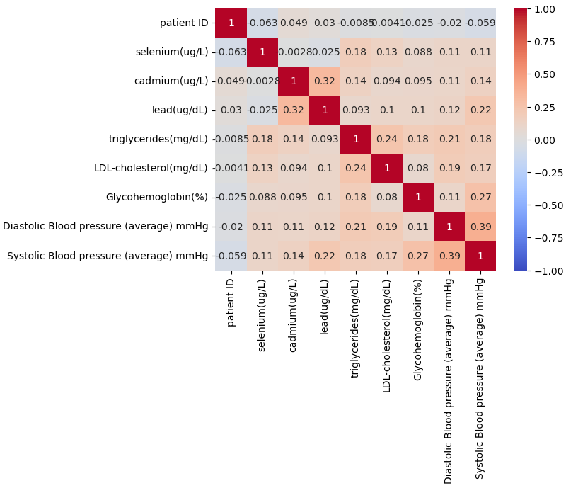
Heat Map Comparisons

Slide 21
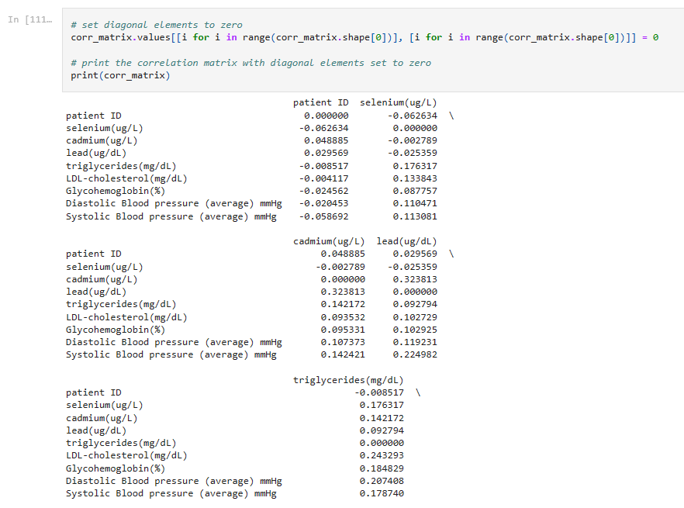

Slide 22
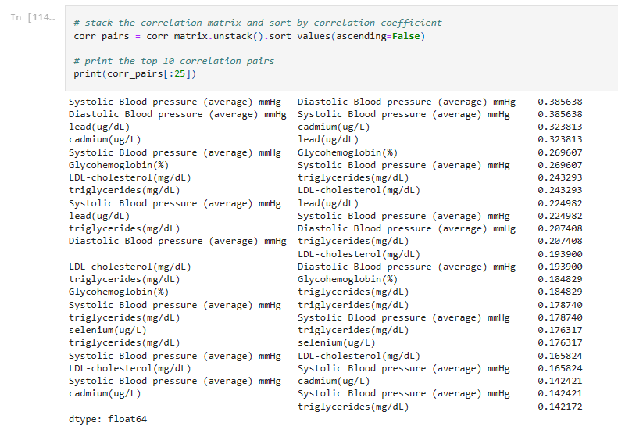

Slide 23
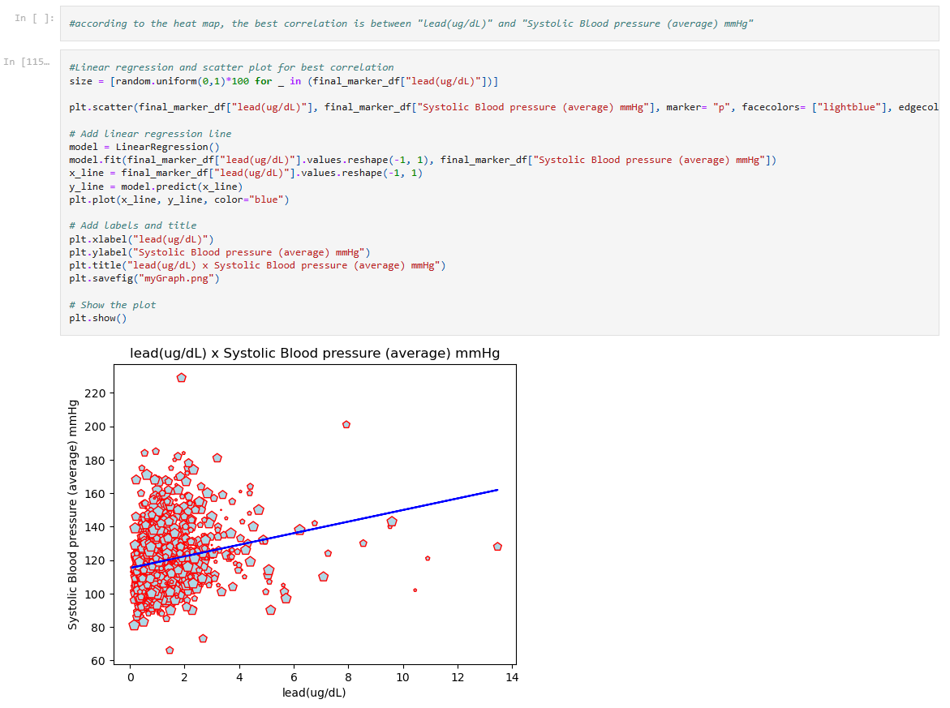

Slide 24
Analysis and Conclusion
Heat map 22: A positive correlation between selenium and triglycerides could suggest a possible relationship between selenium intake and lipid metabolism. Similarly, the correlation between cadmium and triglycerides could indicate a potential link between cadmium exposure and lipid metabolism. The correlations between lead and LDL-cholesterol, selenium and LDL- cholesterol, and Mercury and LDL-cholesterol suggest a potential association between these variables, but further research would be needed to investigate the nature of this relationship. However, the numbers as well as the plot scatter indicate that overall, the correlation are insignificant. So, no predictive power is expected from the existing variables. The most correlated variable is Cadmium, with a correlation of 0.5 to triglycerides. To measure the regression lines’ performance, a test dataset could be used to calculate the errors and select the best variable based on the regression model. Table 26: Exposure to, lead and cadmium is associated with an increased risk of cardiovascular disease and coronary heart disease, as we can see they can increase amount of LDL and triglycerides directly. selenium is not associated with cardiovascular risk. These findings reinforce the importance of environmental toxic metals in cardiovascular risk, beyond the roles of conventional behavioural risk factors (BMJ 2018;362:k3310). Cadmium Box plot (28): The data set for cadmium concentration in blood showed that the first quartile was 0.15 ug/L, representing the 25th percentile, while the third quartile was 0.53 ug/L, representing the 75th percentile. The interquartile range (IQR) was calculated as 0.38 ug/L, which is the difference between the third and first quartiles. Based on the lower and
upper boundaries for outliers, which were -0.42 and 1.1 ug/L, respectively, there were no lower outliers, but 126 upper outliers were identified, which fell above the upper boundary for outliers. After analyzing the chosen biomarkers in the dataset, no meaningful correlations were found with the blood metal concentrations. As a result, we are including new heart biomarkers in the dataset, which are reported in the literature to be related to the consumption of heavy metals. By doing so, we hope to gain a better understanding of the possible effects of heavy metal exposure on heart health. To come up with more predictive variables we added a number of additional factors, including blood pressure and glycohemoglobin Looking at the correlation heat map and the plots it can be observed that there is a slightly higher correlation between lead and blood pressure. This suggests that blood pressure may be a more predictive variable for lead levels than glycohemoglobin.

